Slide 1
Business Analytics Introduction
Yi Zhang

Slide 2
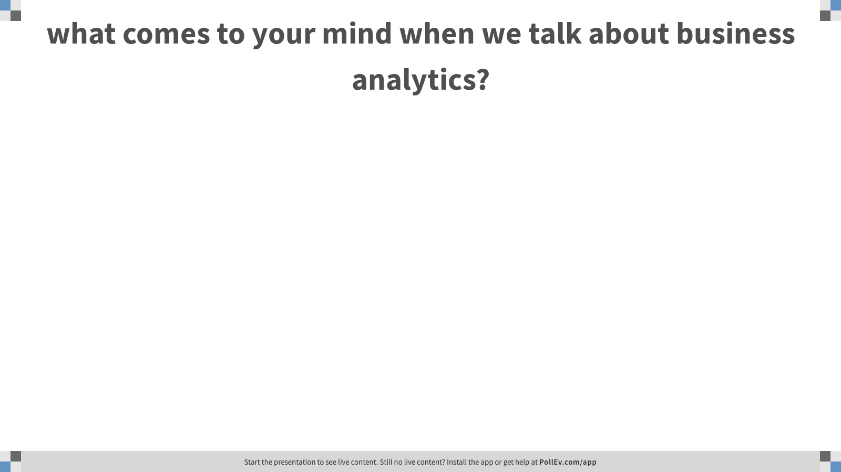
Notes:
Poll Title: what comes to your mind when we talk about business analytics? https://www.polleverywhere.com/free_text_polls/WoKlxgDPv09dosPfIcvhx

Slide 3
What is Business Analytics?
Business analytics (BA) refers to the skills, technologies, practices for continuous iterative exploration and investigation of past business performance to gain insight and drive business planning. [Wikipedia]

Slide 4
Okay, let’s make BA more understandable.
Use data to learn something useful for the business.
Use data to predict something of importance to them.
Use “past data” to infer a model that fits the data.
Use these learned models to give meaningful business recommendations.

Slide 5

Sadly, the reality is

Slide 6
What kind of problems we might encounter as business analysts?
How do we develop a model to predict market sales?
How do we model consumer choices?
How can I simulate the website click? What values to use for the parameters?
How do we identify my loyal customers?
How can I do personalize product recommendation for my customers?
How do we design an experiment to measure the effectiveness of a big market campaign?
How do we best allocate our sales force?
…

Slide 7
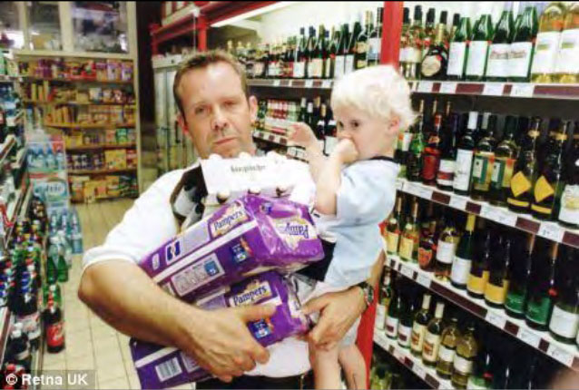
Case 1: Diaper v.s Beer
Men between 30- 40 years in age, shopping between 5pm and 7pm on Fridays, who purchased diapers were most likely to also have beer in their carts.
This motivated the grocery store to move the beer isle closer to the diaper isle: instant 35% increase in sales of both.
Urban Myth?
https://canworksmart.com/diapers-beer-retail-predictive-analytics/

Slide 8
Case 1: Diaper v.s. Beer
Okay, let’s go back to the origin of the study
Diaper | Beer
0 | 0
0 | 1
0 | 1
1 | 0
1 | 1
0 | 0
0 | 0
1 | 1
0 | 0
1 | 1
A study conducted in June of 1992
Nothing but using SQL to find the correlation between the sales of two products in an unclosed mid-west retail store

Slide 9
Case 1: Diaper v.s. Beer
If you are a business analyst of a super market, what is your recommendation?
Is this applicable to my store? How?
How do I design an experiment to validate?
How do I measure the effect?
How strong is the correlation?
Is the correlation statistically significant?
Impact from other factors?
Diaper | Beer
0 | 0
0 | 1
0 | 1
1 | 0
1 | 1
0 | 0
0 | 0
1 | 1
0 | 0
1 | 1

Slide 10
Case 1: Diaper v.s. Beer
Challenges?
Maybe the diapers are and beers are already in adjacent isles
Move them further away -> Loss of business?
Convincing your manager to do an experiment can be pretty difficult
You need to explain carefully why your proposal works with strong support
Like a sales pitch…

Slide 11
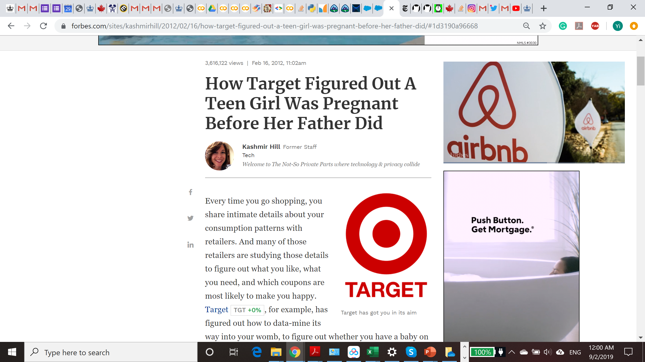
Case 2: Pregnancy Prediction
An angry father noticed that his high school daughter received coupons for baby clothes and cribs from Target.
Well, turns out that his daughter was indeed pregnant
https://www.forbes.com/sites/kashmirhill/2012/02/16/how-target-figured-out-a-teen-girl-was-pregnant-before-her-father-did/#407199d66668

Slide 12
Case 2: Pregnancy Prediction
Any guess how this is done?
A woman is predicted to be pregnant if she buys enough of roughly 25 "pregnancy indicator" products like unscented lotion or vitamins

Slide 13
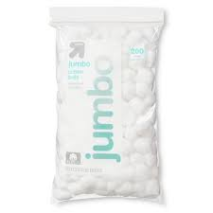
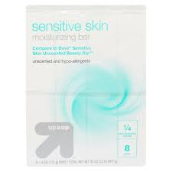
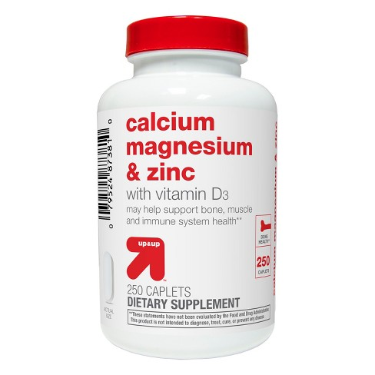
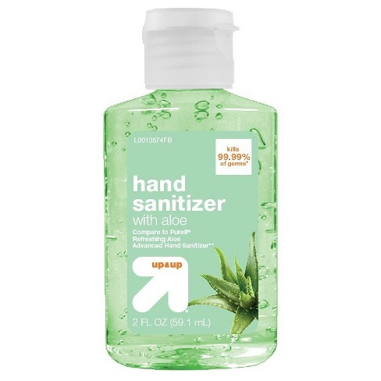

Case 2: Pregnancy Prediction
Wait, there is more than that! Creepy…
How does this bring business value?
Close to the delivery date
In the first 20 weeks

Slide 14

Types of analysis
Descriptive Analysis
Provide insight into the past. Here, we want to make to ask “What has happened?”
Predictive Analysis
look into the future. Here, we want to ask “What could happen in the future?”
Prescriptive Analysis
Uses optimization and simulation algorithms to advice on possible outcomes and answer: “What should we do?”
Business Analytics $≠$ Machine Learning

Slide 15
How much is BA used in the industry?
Descriptive Analytics:
Around 90% of companies use descriptive analysis.
Predictive Analytics:
Just 28% of U.S. businesses use predictive analytics, the majority surveyed consider it to be “critical” or “very critical.”
The global market for predictive analytics is expected to triple to about $10.95 billion by 2022, from $3.49 billion in 2016.
Forbes Insights report found that 86% of executives who used predictive marketing for at least two years reported an increased return on investment.
Prescriptive analytics:
Very preliminary
https://www.dezyre.com/article/types-of-analytics-descriptive-predictive-prescriptive-analytics/209
https://www.salesforce.com/blog/2019/07/what-is-predictive-analytics.html

Slide 16
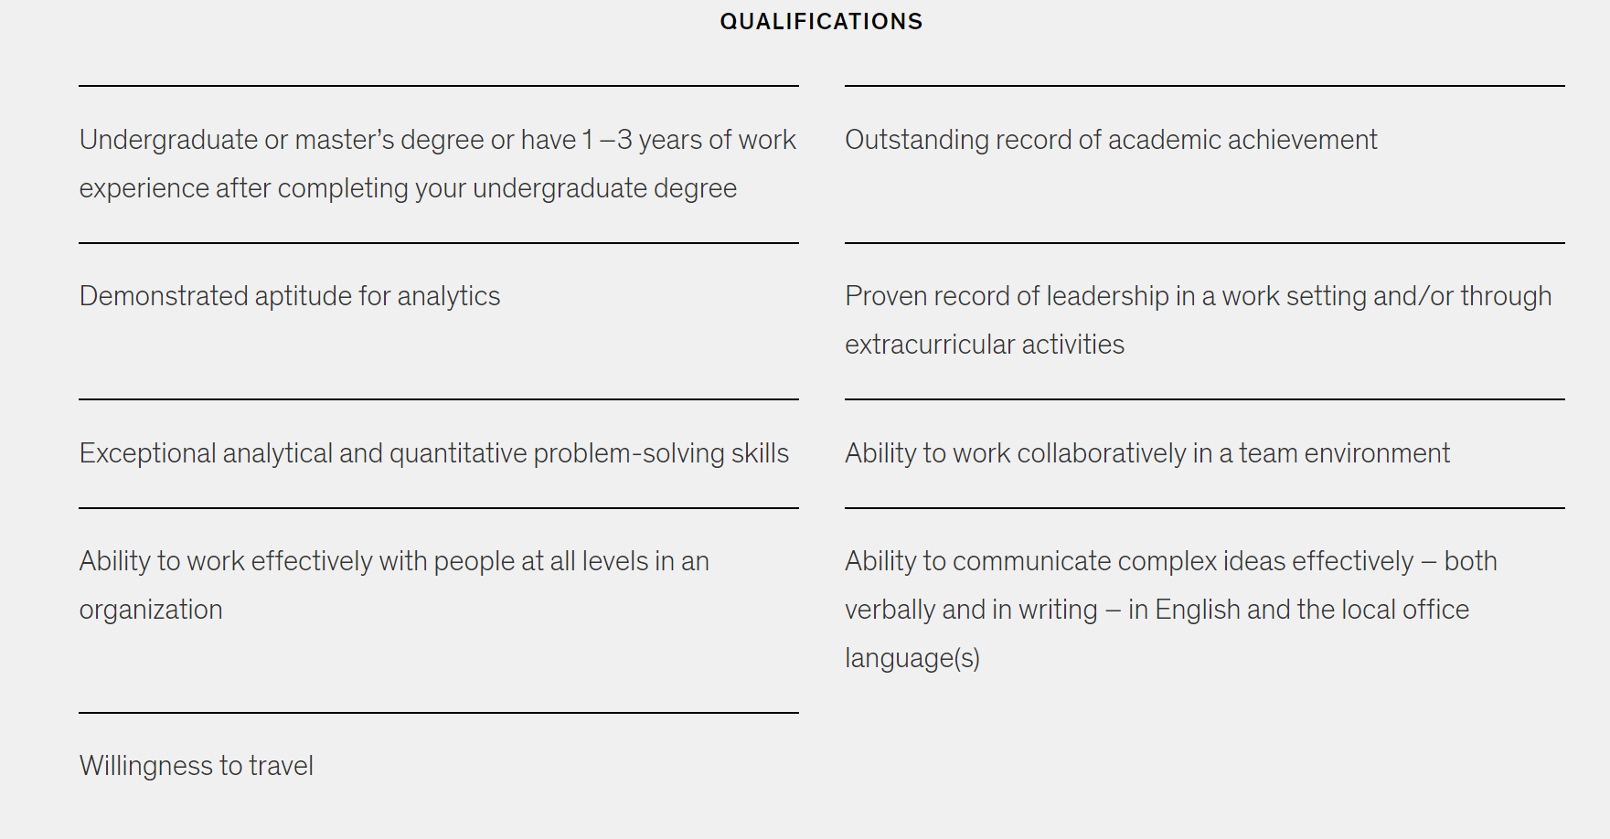
Sample job qualifications for a BA position
https://www.mckinsey.com/careers/search-jobs/jobs/businessanalyst-15136

